Slide 1
2014 Trends in Hospitality Training
& Development Study

Slide 2
30,000 + Restaurants | 1 Million Employees | $40 Billion Sales
Human Capital
Performance
Brand Experience
Financial Capital
Performance

Slide 3
The Big Picture – State of the Restaurant Industry

Slide 4
Restaurant Industry Sales Performance
Source: Black Box Intelligence

Slide 5
Comp Sales and Traffic by Region, June YTD
Source: Black Box Intelligence

Slide 6
Fueling the Growth for the Industry Q4 2013 – YOY Growth
3.6%
Total sales growth
1.5%
Restaurant unit growth
Source: Black Box Intelligence – Market Share Report

Slide 7
Unit Growth by Segment 2013
Segment | Unit Growth
Quick Service | 1.1%
Fast Casual | 7.7%
Family Dining | 0.6%
Casual Dining | 1.8%
Upscale Casual / Fine Dining | 3.4%
Source: Black Box Intelligence – Market Share Report

Slide 8
Hotel Industry Revenue Growth 2013
5.4%
Total revenue growth
Source: American Hotel and Lodging Association

Slide 9
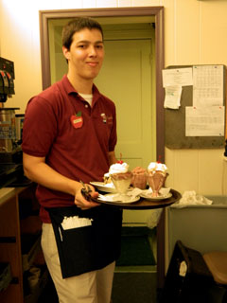
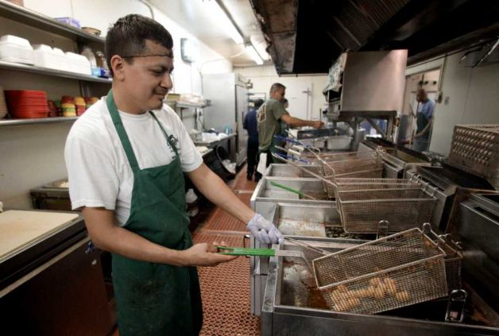
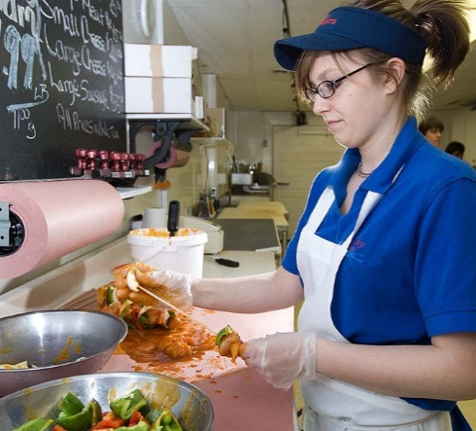

Slide 10
Hourly Turnover Continues to Inch Up
Source: People Report

Slide 11
Restaurants Rely on
Part-Time Employees % of employees working less than 30 hours per week
66%
Limited Service
70%
Full Service
Source: People Report

Slide 12
Managing the Cost Increases of ACA
Source: People Report
Source: People Report - 2013 Health Care Survey presented by Castlight

Slide 13
Restaurant Hourly New Hires by Age - 2013
Segment | 25th Percentile | Median | 75th Percentile
Quick Service | 18 | 21 | 27
Fast Casual / Family | 19 | 21 | 27
Casual Dining | 19 | 22 | 28
Upscale Casual | 21 | 24 | 30
Source: People Report

Slide 14
Restaurant Hourly New Hires by Race / Ethnicity - 2013
Source: People Report

Slide 15
Trends in Hospitality Training
& Development Study
Results

Slide 16
Profile of Participating Companies
 | # of companies | Avg. # of locations | Avg. # of hourly employees | Avg. # of unit level managers
Restaurants | 44 | 157 | 4,187 | 365
Hotel & Lodging | 11 | 1,399 | 12,051 | 2,804
Other | 1 | -- | -- | --
Total | 56 | 183

Slide 17
Participating Restaurants by Segment
 | # of companies | Avg. # of locations | Avg. # of hourly employees | Avg. # of unit level managers
Limited Service | 21 | 347 | 5,128 | 527
Full Service | 21 | 73 | 3,568 | 236
Both | 2 | -- | -- | --

Slide 18
Training Spending and Budgets

Slide 19
1.0%
(Median)
Training Budget
(Excluding Salaries)
as Percentage of Sales
No relationship found between size of company in sales and relative size of training budget

Slide 20
Distribution of Training Budget

Slide 21
Distribution of Restaurant Training Budget

Slide 22
Hotel & Lodging – Training Expense Increasing Slightly

Slide 23
Restaurants– Training Expense Growing More Significantly

Slide 24
Restaurants - Training Expense Growth % of companies with growing training expense

Slide 25
The Training Function

Slide 26
Hotel & Lodging – Number of People in Training Department Stabilizing

Slide 27
Restaurants–Still Showing Some Growth in Number of People in Training Department

Slide 28
Training Typically Reports to Operations % of companies by who training reports to

Slide 29
Discussion
The Training Department:
Spending and Reporting Relationships

Slide 30
Training Practices

Slide 31
Limited Service Restaurants Target Almost 50% More Employees Per Trainer
Target number of FTE unit level employees per FTE unit level trainer

Slide 32
Trainers Needed Per New Unit Opening

Slide 33
Training The Trainers Dollars Allocated To Training Certified Trainers
 | % of Training Dollars
Hotel & Lodging | 9%
Restaurants | 6%
Limited Service | 5%
Full Service | 7%

Slide 34
It Pays To Train The Trainers Unit level hourly turnover by % of budget spent on training certified trainers

Slide 35
Most of the Training Time Offered to Unit Level Hourly Employees (except in Limited Service Restaurants)

Slide 36
Training Hours Offered Annually
Position | Average # of hours | Training hours as % of MIT training
Managers in Training (MIT) | 338 | 100%
Franchisee Operator Program | 121 | 36%
Unit Level Hourly Employees | 62 | 18%
Veteran Managers at GM Level | 55 | 16%
Multi-Unit Managers | 47 | 14%
Veteran Managers at Assistant Mgr. Level | 44 | 13%
Department Managers | 43 | 13%
Other Salaried Management | 31 | 9%
No relationship could be found between MIT training hours and management turnover based on sample available

Slide 37
Who Trains Unit Level Hourly Employees?

Slide 38
How Are Orientations Conducted for New Hourly Employees?

Slide 39
New Hourly Employee Orientation
3.5 hours
Median number of hours offered
2 hours
Most frequent response (20% of companies)

Slide 40
Hourly Employee Orientation and Turnover
Hourly Employee
Turnover
Hourly Employee
Turnover

Slide 41
How Are New Hires Trained? % of training provided

Slide 42
Restaurants - Weeks of New Employee OJT
Position | OJT Weeks
Front-of-house Hourly | 1
Back-of-house Hourly | 2
Assistant Manager | 7
Kitchen Manager | 8
General Manager | 7
Notes:
.

Slide 43
Discussion
Training Practices:
Orientation and Training the Trainer

Slide 44
Training Delivery and Content

Slide 45
Training Content Creation
49%
Of companies create all training content internally
51%
Of companies create training content both internally and externally

Slide 46
It is common to contract outside services for training department projects
 | % of companies that employ outside services
Hotel & Lodging | 73%
Restaurants | 45%
Limited Service | 40%
Full Service | 50%

Slide 47
External Resources Usage Growing
11%
Percentage of training budget spent on external resources in 2013
51%
Percentage of companies that said expenditure increased compared with 2012
40%
Percentage of companies that expect this expense to increase in 2014

Slide 48
E-Learning Training
% of companies providing
73%
Hotel & Lodging
81%
Limited Service Restaurants
48%
Full Service Restaurants

Slide 49
E-Learning Training On the Rise
% of companies reporting increase in use for 2014

Slide 50
E-Learning – Primary Uses
Knowledge leveling
Validation / Testing
Compliance
(Food Safety, Allergens, Alcohol, Harassment Prevention, etc.)

Slide 51
How Are We Spending Our Time? % of training time
 | Unit Level Hourly Employees | Unit Level Management
Basic Job Skills | 46% | 22%
Customer Service | 18% | 15%
Culinary Skills | 9% | 6%
Food Safety/Sanitation | 5% | 4%
Compliance - OSHA, Fire Prevention, Safety | 4% | 4%
HR Programs - Diversity, Harassment, etc. | 3% | 6%
Interpersonal Skills - Conflict Mgmt. Teamwork, etc. | 1% | 5%
Leadership/Executive Development | 1% | 8%
Supervisory Skills - Interviewing, Coaching | 1% | 6%
Financial Management | 1% | 7%

Slide 52
Se Habla Español
% of companies that offers training materials in Spanish
70%
Hotel & Lodging
70%
Limited Service Restaurants
53%
Full Service Restaurants

Slide 53
Focus of Bilingual Training: BOH
% of companies of those that offer bilingual materials

Slide 54
Ongoing Training:
Food Safety / Sanitation % of companies that offer training every 3 months or more frequently

Slide 55
Discussion
Training Delivery:
E-Learning and Developing Softer Skills for
Unit Level Hourly Employees

Slide 56
Key Insights
Multi-unit managers: area of opportunity regarding training time allocation
Training department is now more likely to report to operations or the President/CEO, as compared to reporting to HR
It pays to train the trainer in terms of decreasing unit level turnover
It pays to invest in orientation; helps reduce turnover through early engagement of new employees

Slide 57
Key Insights
Usage of external resources is on the rise as trainers continue to do more with less
Delivery via e-learning is on the rise and is particularly effective in the areas of knowledge leveling, validation, and compliance topics
Soft-skills training for unit level hourly employees is an area of opportunity.

Slide 58
Trends in Hospitality Training
& Development Study
Results Publication
In depth report available to all CHART members
Additional information beyond this presentation:
Training department salaries and target bonuses
Employee engagement surveys
Greater detail on training content delivery
Available in August

